Slide 1


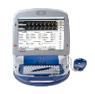

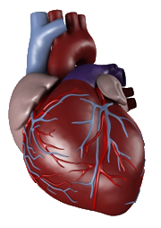
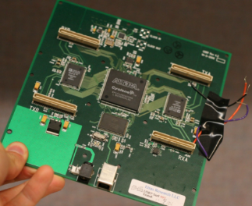
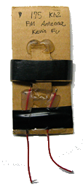
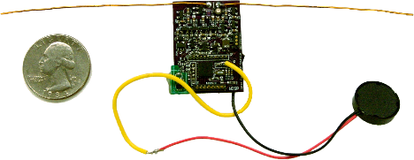
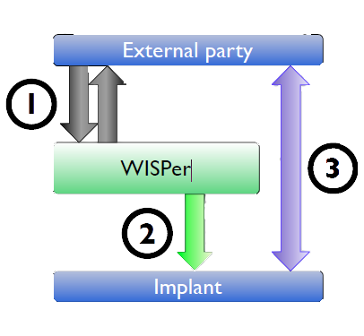

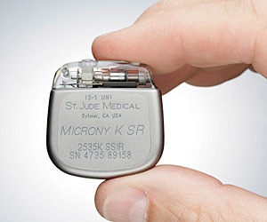
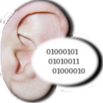
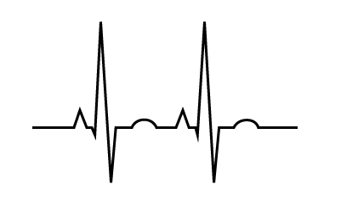


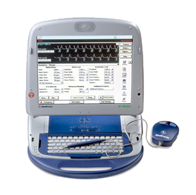
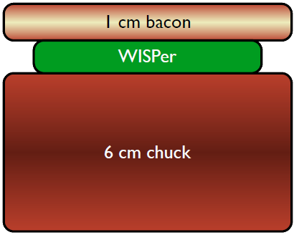


Pacemakers and Implantable Cardiac Defibrillators: Are they really secure ?
Attacks
Defense
Steal a Device Programmer
Need for Reverse Engineering, Modifications
Easy to get root mode
Problem : difficult to set up
Build your own Device Programmer !
Total cost : 800 $
Eavesdropping on private Information
What kind ? => Implanting physician, Diagnosis, Hospital,
Device state, patient name, date of birth, serial N°, etc...
The future holds some promises : devices more sophisticated
ergo a lot more data to be divulged ?
Sniff Vital Signs
Get the vital signs that the ICD emits
Need to have an Eavesdropping setup
Drain energy
Send multiple radio signals to the ICD (“Are you sleeping ?”)
=> Battery lifetime decrease
Simple : transmit-only
Turn off therapies
“Stop detecting fibrillation”
Problem : change of the device state
Affect patient’s physiology
Induce fibrillation, flood with drugs
Problem : patient’s safety at great risk
Solutions ?
Authenticate device programmers ?
Encryption ? Passwords ?
Problems
Need emergency access !
Patient’s health : top priority
Prototypes defenses VS some of the attacks
Idea : defend without using battery
Example of prototype : WISP = RFID + computation
WISPer = WISP + code
ICD
control
Device Programmer

